Slide 1

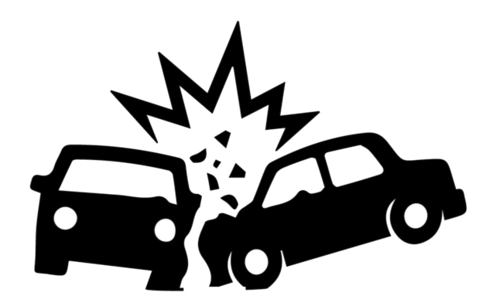
Analysis on Motor Vehicle Collisions

Slide 2
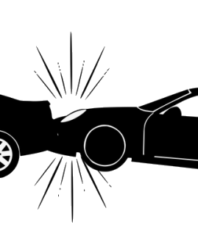
Team Introduction
Group Number : 06
Section Number : 004
Team Members:
Deepak Mathaiah Pattem
Joel Soloman Raj Addala
Jerusha Sheba Maben
Manushree Venkatesh
Ram Sundar Thanumalaya Perumal

Slide 3

motivation
New York City is the most populated city in the United States of America. As a result, it is not surprising that there is a lot of traffic in the city, which increases the likelihood of accidents.
Statistical research conducted by analysts at Jay S. Knispel revealed that there were over 88k accidents in 2020 alone. Considering that the epidemic kept most of the year behind lock and key, that is a lot. Since then, the world has mostly recovered from the epidemic; thus, the traffic problem is only going to become worse. (New York City Car Accident Statistics - 2020 Update. (n.d.). Retrieved from Law Offices of Jay S. Knispel, LLC website: https://jknylaw.com/new-york-car-accident-lawyer/statistics/)
By understanding and analyzing the contributors to these accidents in NYC, it is possible to raise public health and safety and reduce the occurrence of accidents in other cities in similar situations.

Slide 4
Problem statement
Car accidents are a major concern regarding the safety of the population in densely populated cities. In most cases despite the government's efforts to improve road safety, car crashes continue to occur every year. This project is set to analyze an NYPD data set recording car accidents in New York cities to understand the contributing factors and aid in developing strategies for the prevention of such accidents.

Slide 5
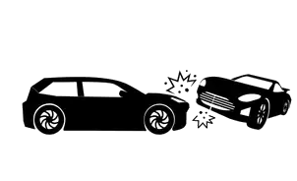
Project Proposal
Our team intends to identify patterns using descriptive analysis, to gain a better understanding of how, why, and when these accidents occur. With those parameters, we aim to find leading causes. This will help provide clarity on which contributors to focus on to reduce car crashes dramatically.

Slide 6
Data set description
This data set is the collection of all the motor vehicle collisions recorded by the NYPD, available on the data.gov site.
This data set contains incidents from 2016 till 2022
In total there are 3,704,406 records and 25 variables in the data set.
The Records are subset to make the data manageable for this analysis. For this we take into consideration the incidents that occurred from 2019 till 2021.
This makes the effective shape of the dataset to be 868,831 records and 25 variables.

Slide 7
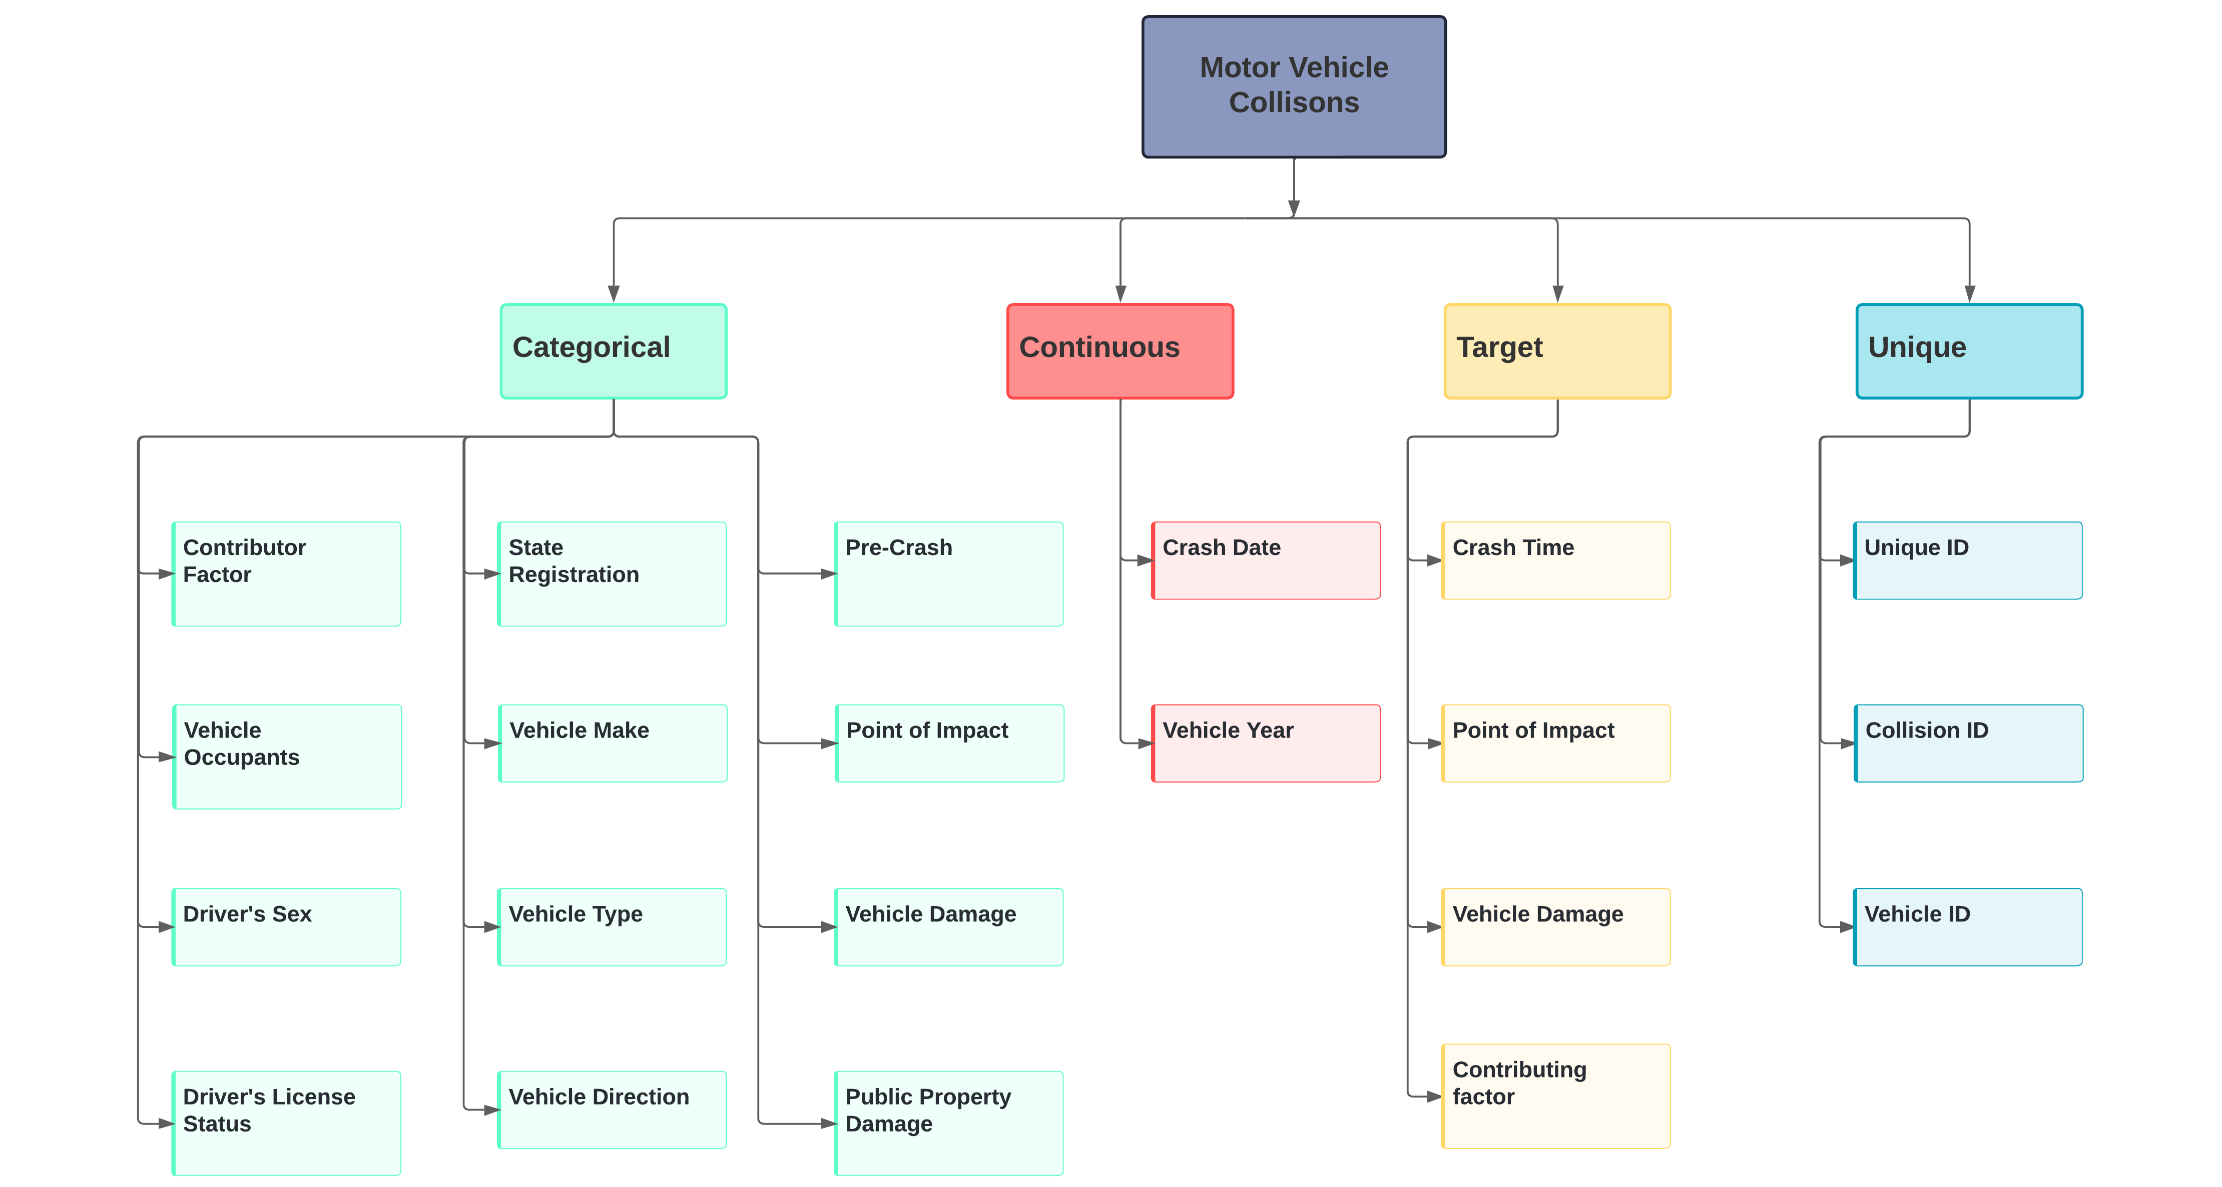
Data set description

Slide 8
Analysis Questions
Which are the largest contributors to car crashes?
What was the state of the cars before they crashed?
What is the relation between time and frequency of car crashes?

Slide 9
Data Cleaning
Individual cleaning for individual analysis questions
Process includes Subsetting, Cleaning, and Grouping

Slide 10
Data Cleaning: Analysis Question 1
Largest Contributors in motor vehicle crashes

Slide 11
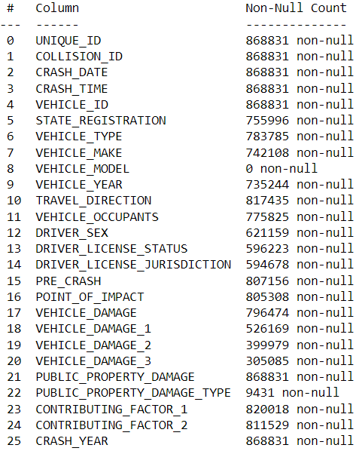
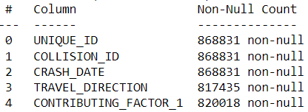
Subsetting
Before
After

Slide 12
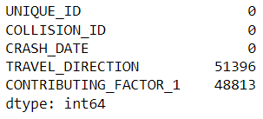
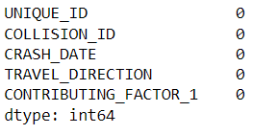
Dropping NA’s
Before
After

Slide 13
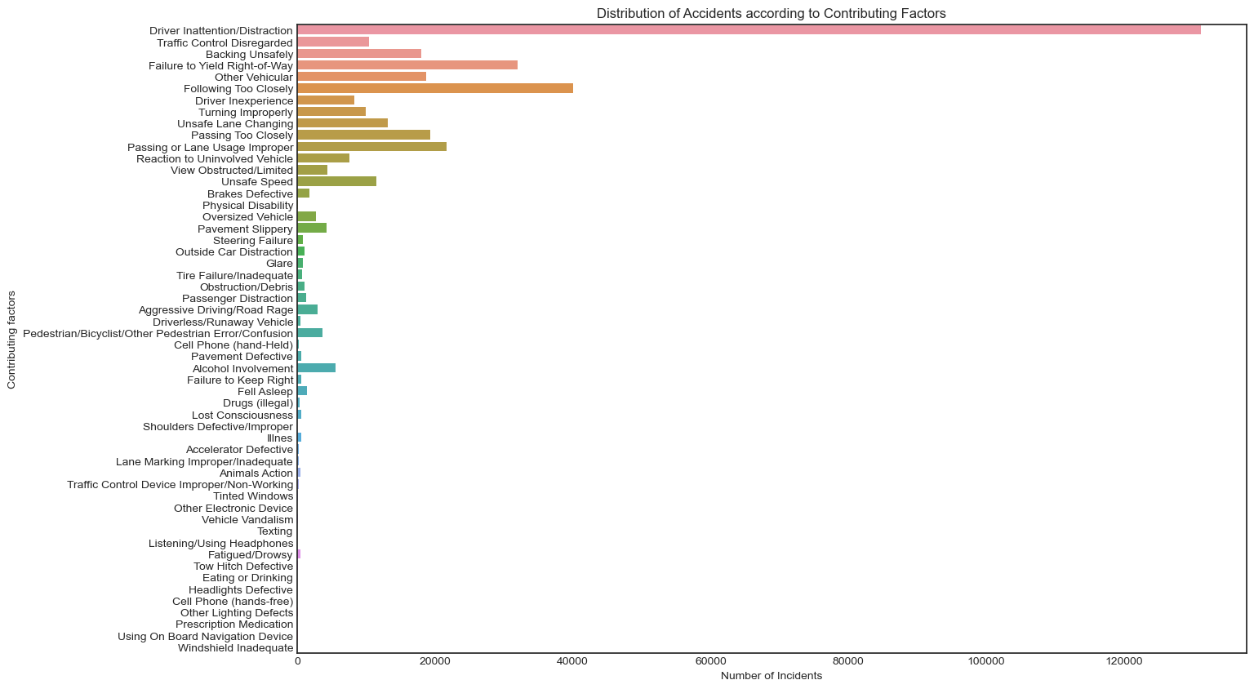
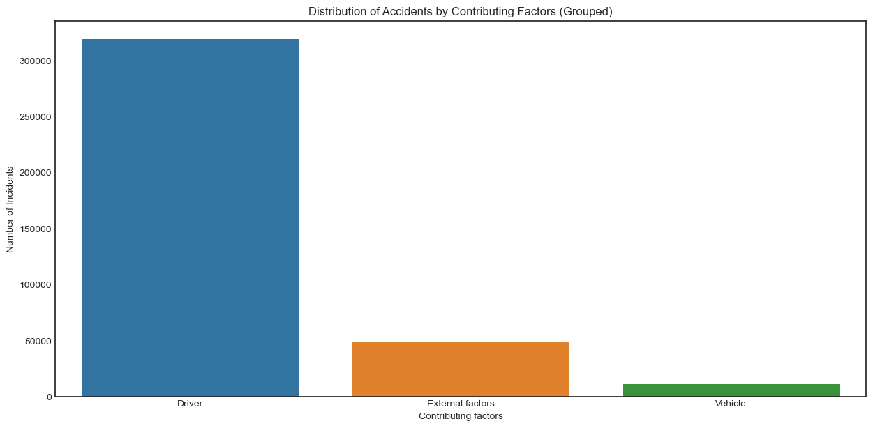
Grouping
Before
After

Slide 14

Which are the largest contributors to car crashes?

Slide 15
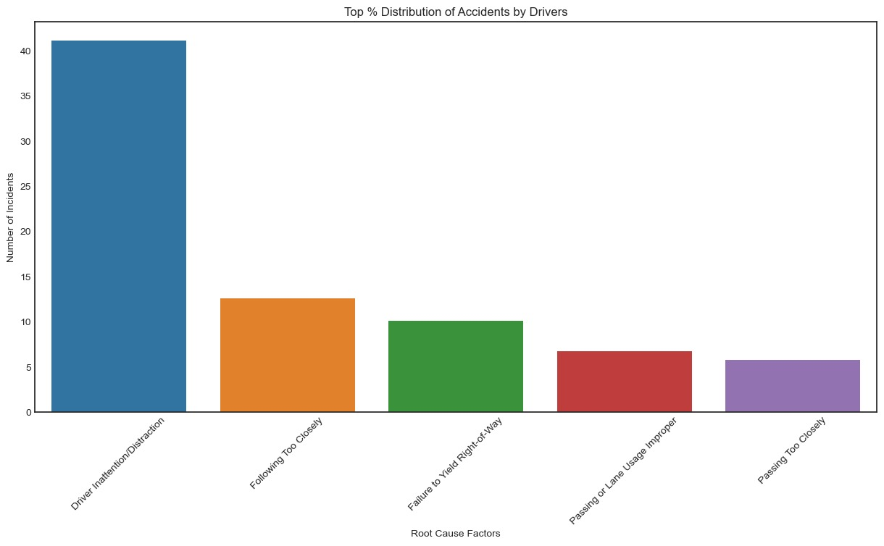
Leading Driver Related Factors

Slide 16
OBSERVATIONS
Drivers were solely responsible for over 300,000 accidents.
External Factors contributed to about 50,000 accidents
Vehicular Malfunctions led to about 15,000 accidents.

Slide 17
Data Cleaning: Analysis Question 2
What was the state of the car before it crashed?

Slide 18
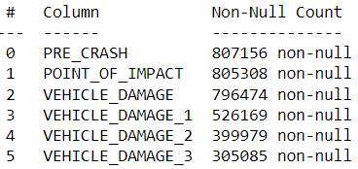
Subsetting
Before
After

Slide 19
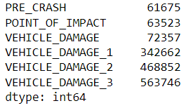
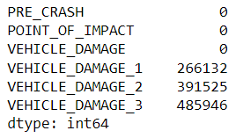
Dropping NA’s
Before
After

Slide 20
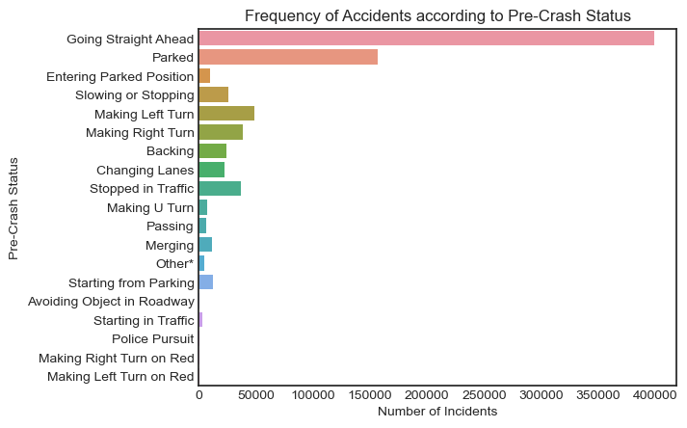
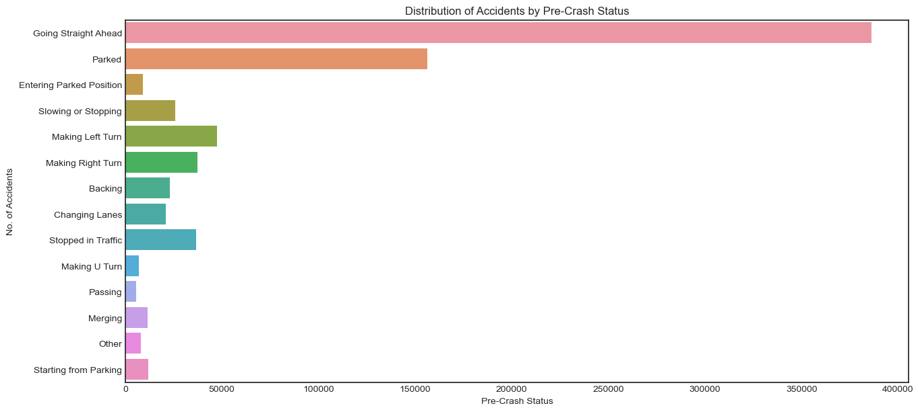
Grouping
Before
After

Slide 21
What was the state of the cars before they crashed?

Slide 22
OBSERVATION
About 390,000 accidents were caused by Cars Moving Ahead
Parked cars and cars that were making a left turn accounted for a little over 150,000 & 50,000 accidents, respectively.
Cars that were Passing and Making a U Turn were the least contributing factors.

Slide 23
Data Cleaning: Analysis Question 3
What is the most Frequent Time of day, accidents happen?

Slide 24
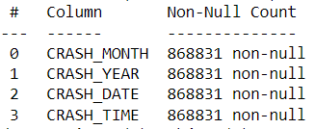
Subsetting
Before
After

Slide 25
Dropping NA’s
There were no Null values, so we didn’t clean

Slide 26
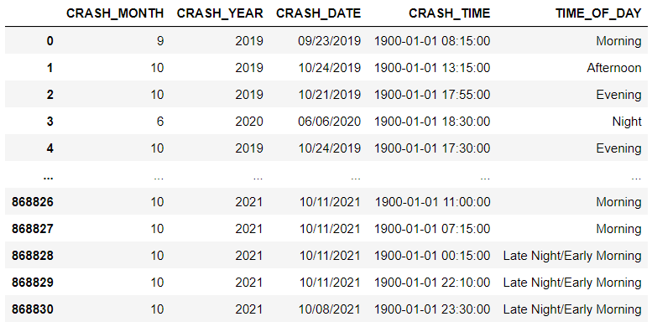
Grouping

Slide 27
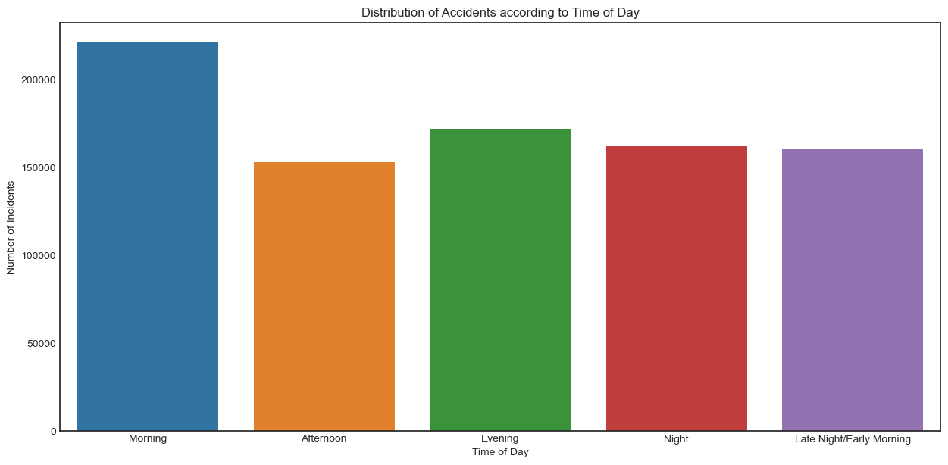
What is the relation between time and frequency of car crashes?

Slide 28
OBSERVATION
Morning accounts for 200,000 incidents.
Over 150,000 accidents happen every year on the Evening.
Evening and Late Evening/Early morning driving contributed to the same number of collisions.

Slide 29
Crashes according to Every Month and Year

Slide 30
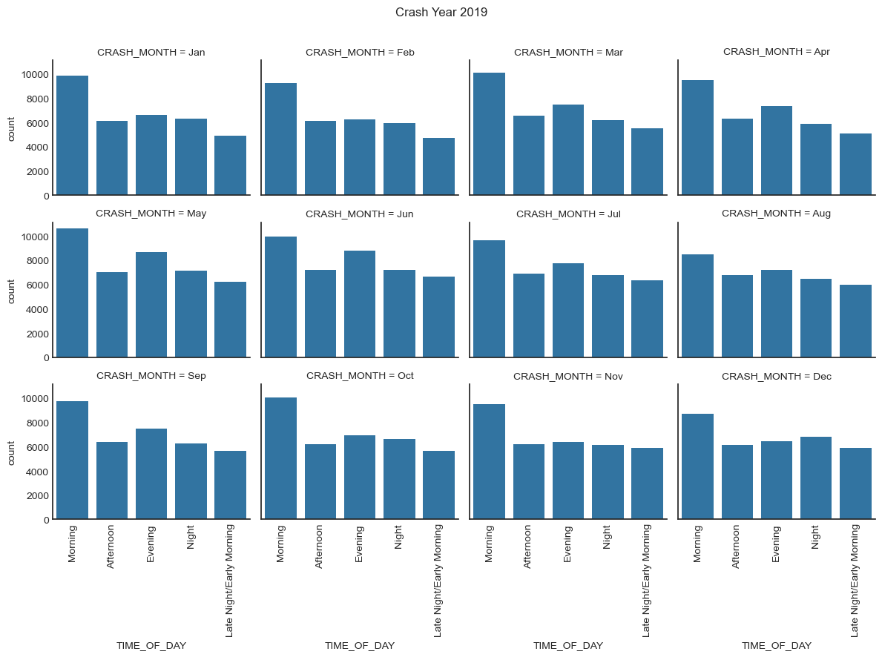
CRASHES IN 2019

Slide 31
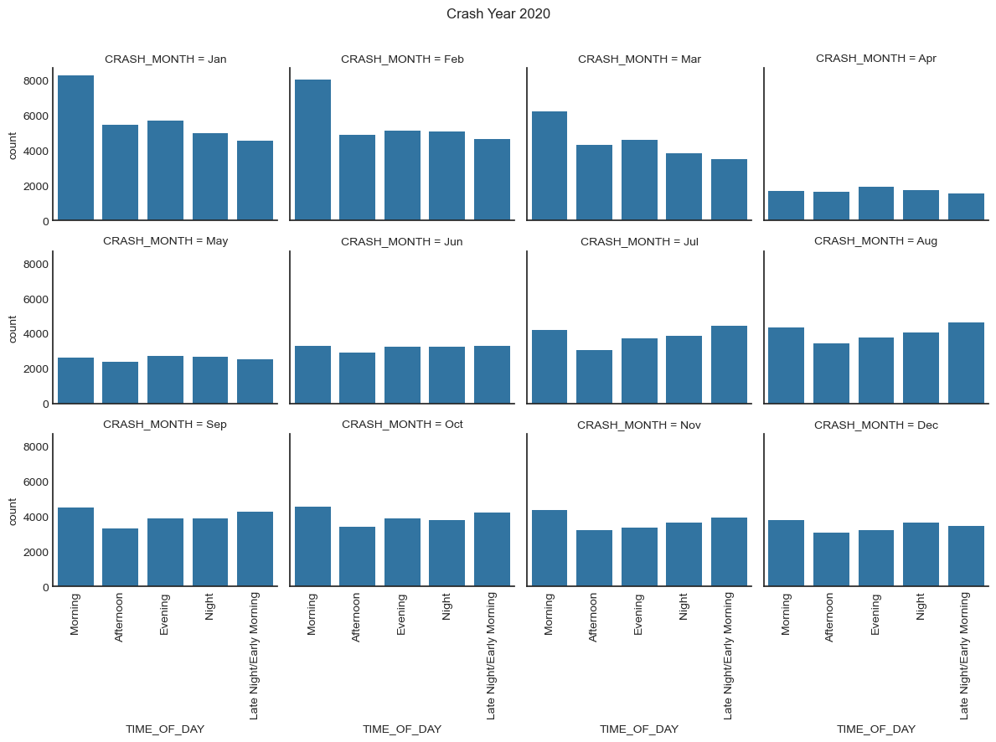
CRASHES IN 2020

Slide 32
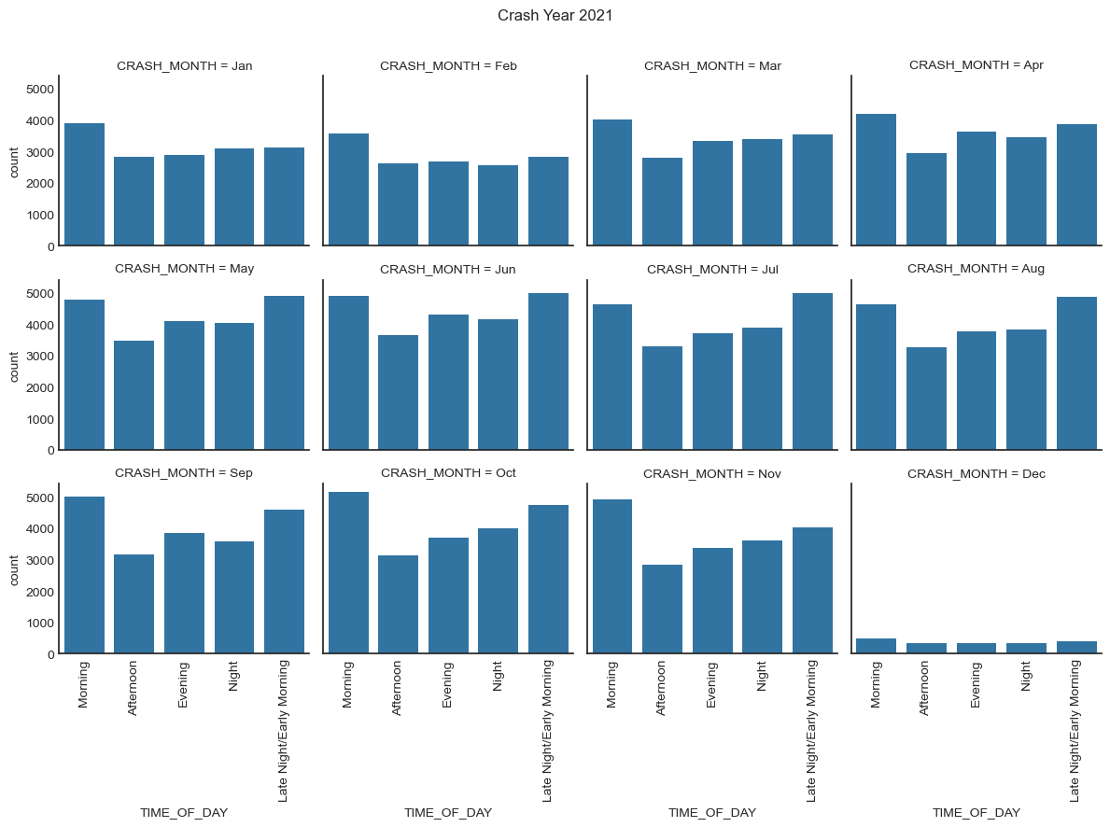
CRASHES IN 2021

Slide 33
OBSERVATION
In most cases, accidents occurred in the Morning.
2020 in general saw the fewest accidents.
2021 saw a gradual increase in the number of accidents

Slide 34
Recommendations
Strong restrictions and penalties can be applied to motorists who engage in any type of distraction while driving, including using their phones.
Enforce rules: 3 second follow and maintaining 2–3-meter distance at stop signs.
Ensure that there are police there to supervise the flow of traffic during mornings, and those who break the laws must face severe fines.
Government can ensure that there are no obstructions that hold back traffic during rush hours.

Slide 35
Reference
New York City car accident statistics - November 2022 update. Law Offices of Jay S. Knispel Personal Injury Lawyers. (2023, March 14). Retrieved April 14, 2023, from https://jknylaw.com/new-york-car-accident-lawyer/statistics/

Slide 36

THANK YOU

